Slide 1

-----------
Hybrid Clustering Technique for MRI Brain Segmentation to Identify Vestibular Schwannomas
Yves Greatti & Heather Grimaudo
EN.585.703.81.FA24 Applied Medical Image Processing

Slide 2
INTRODUCTION
Background:
Brain MRI segmentation is critical for diagnosing and planning treatment for various pathologies.
Manual segmentation is time-consuming and prone to error; automated methods offer efficiency and reproducibility.
Focus of Study:
Vestibular schwannomas: Benign tumors on the vestibulocochlear nerve with unique MR imaging features.
Challenge: Improve segmentation accuracy using hybrid clustering methods.

Slide 3

PROJECT IDEA
Implement and evaluate a hybrid segmentation algorithm combining fuzzy C-means and a modified bat algorithm on MR imaging to identify vestibular schwannomas.

Slide 4
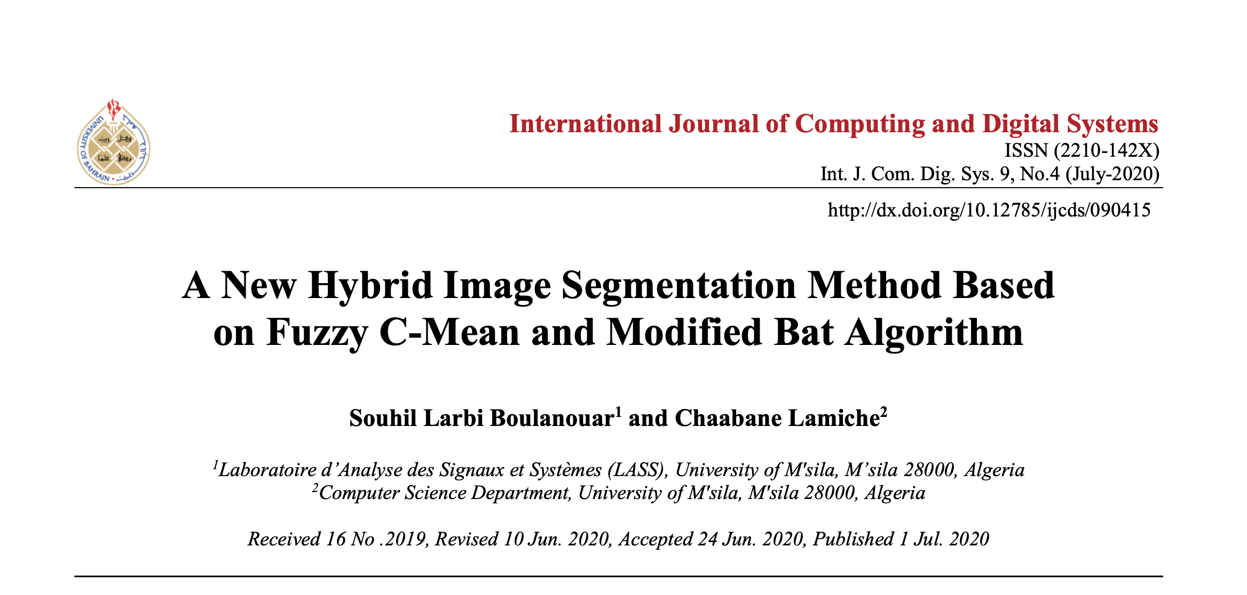

Notes:
Many papers have tried to improve the Fuzzy C- Mean algorithm using metaheuristic approaches inspired by nature, for example one is related to fireflies, the fireflies representing the optimal solution or like in this paper bat behaviors.
At the core of these papers, is a cost function which measures the convergence to the optimal solution.
This paper defined a cost function which is based on different cluster metrics looking for compact clusters with minimum overlaps.

Slide 5
PROBLEM STATEMENT
Fuzzy C-Means (FCM) is widely used but has drawbacks:
Sensitivity to noise.
Dependence on initial parameters.
Tendency to converge to local minima.
Objectives:
Combine FCM with a Modified Bat Algorithm (MFBAFCM) to address these limitations.
Improve segmentation metrics such as cluster compactness and separation.

Slide 6
METHODOLOGY
Step 1:
Fuzzy C-Means (FCM) algorithm: Probabilistic clustering assigns pixels to clusters with degrees of membership.
*Shortcomings: prone to noise and poor initialization.
1
Step 2:
Bat Algorithm (BA): Inspired by echolocation in bats, optimizes cluster initialization.
*Uses frequency, loudness, and pulse rate to guide optimization.
*Fitness function minimizes intra-cluster distance and maximizes cluster validity.
2
Step 3:
Hybrid Approach: BA initializes clusters for FCM, which refines them for optimal segmentation.
3

Slide 7
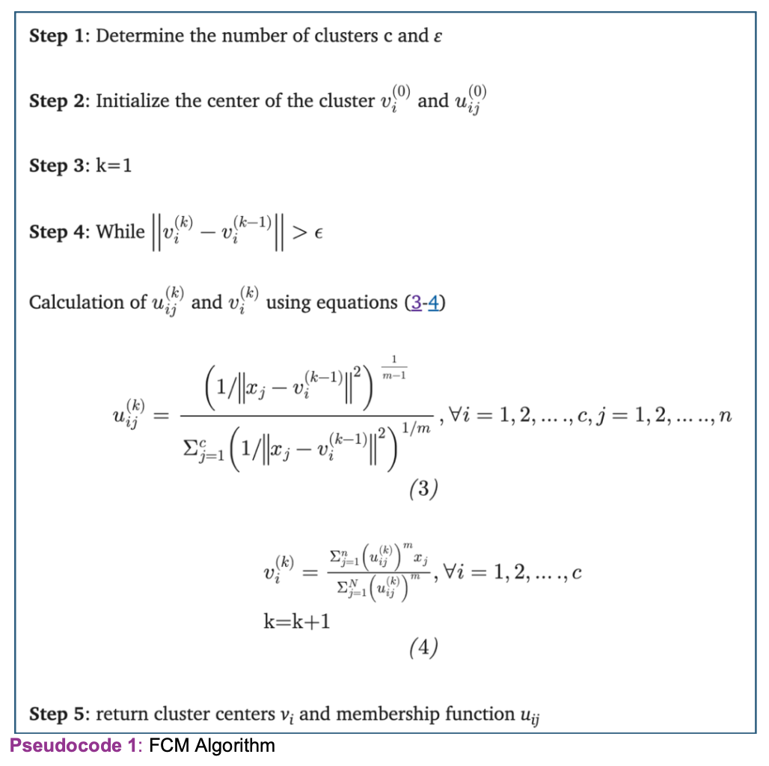
STEP 1: Fuzzy C-Means (FCM) algorithm
Notes:
Fuzzy c-mean algorithm is an unsupervised clustering algorithm, it consists in finding clusters defined in term of membership coefficients, the us and the cluster centers, the vs in this slide.
If we try to reduce a cost function which is proportional to the memberships and a dissimilarity measure between data points for example a distance between points, we obtain analytically for solution equation 3 and 4.
This is an iterative process once we update the membership coefficients, we must update the centroids and since we have new cluster centers, we recompute the membership coefficients and this iterative process continues until the difference (or change) between successive iterations falls below a specified threshold, indicating that the solution is sufficiently close to stability or optimality.

Slide 8
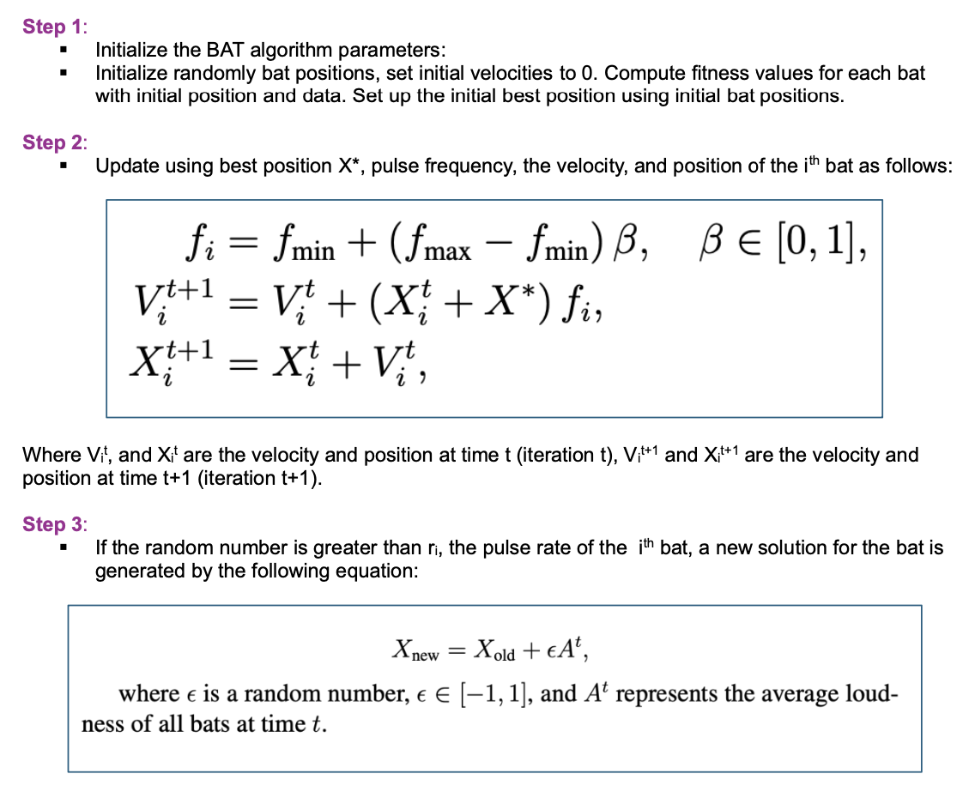
STEP 2: Bat Algorithm (BA)
Notes:
Bats fly randomly initially trying to echo locate a prey, the optimal solution, it has different parameters which we will go through.
Bat Algorithm starts by initializing a population of bats where the position of the bat i is denoted by xi and its velocity denoted by vi at time t.
fi represents the pulse frequency emitted by bat i at the current moment, fmin and fmax represent the minimum and maximum values of pulse frequency.
The new positions xi and new velocity vi at time step t+1 are computed using the formula described in step 2.
The Bat algorithm balances between two main phases: exploration and exploitation.
In step 3, the exploration, a random number (ϵ) is added to the solution, and its range [−1,1] allows the solution to explore both nearby and far-off areas.
The use of pulse rate (ri​) as a condition implies that lower pulse rates lead to new solution to explore, mimicking bats searching in a broader area with less frequent echoes.
The inclusion of average loudness (At) encourages diverse exploration early in the process when loudness is high.

Slide 9
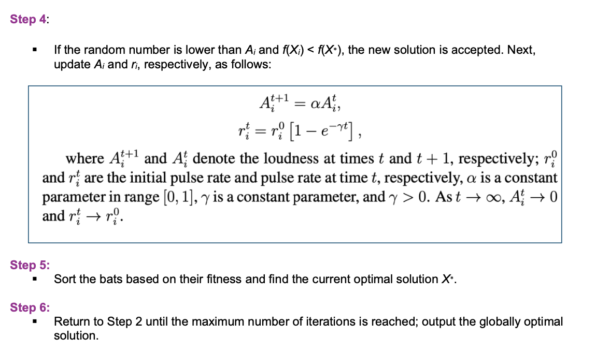
STEP 2: Bat Algorithm (BA)
Notes:
This is the exploitation phase, and its purpose is to refine the search around promising regions of the solution space and focus on finding the optimal solution. Two points to mention:
1. Loudness (At) decreases as iterations progress, reducing the magnitude of random variations and allowing more fine-tuned adjustments to solutions.
2. Pulse rate (ri) increases, meaning bats focus more on the best-known solutions rather than exploring far-off areas.
As you can see using limits to infinity, In the beginning, the loudness is strong, and pulsing rate is small. Once the bat has got its prey, the loudness decreases while pulse rate increases.

Slide 10
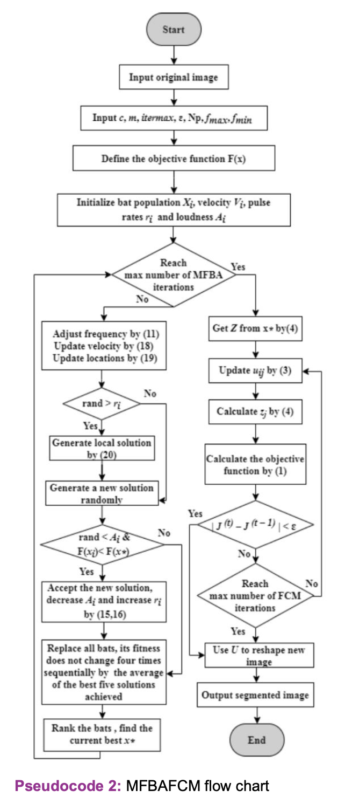
STEP 3: Hybrid Algorithm (MFBAFCM)
Notes:
Step 3 is where we put the two algorithms together: the bat algorithm to find the optimal center clusters and the FCM algorithm.
We made several improvements to MFBAFCM for faster convergence to an optimal solution:
We implemented our own customized Fuzzy C –means algorithm to test different cost function and plug the same cost function as the one used by the BAT algorithm
We also enhanced the cost function by incorporating weighted cluster indices.
We made a variety of improvements to the Bat algorithm itself like detecting bats which do not move and give them a notch to point to another direction
The code manages stagnation in two stages:
Small random changes around the best solution to escape local optima.
Global Restart: Complete reinitialization of solutions to resume the search when stagnation persists.

Slide 11
IMPLEMENTATION
Dataset:
MRI images of 242 patients with vestibular schwannomas from TCIA.
T1-weighted post-contrast images.
Preprocessing:
Median filtering for noise reduction.
Intensity normalization and sliding kernel filters to preserve edges.
Binary masks created using DICOM data to outline tumor regions.
Training and Testing:
80% training, 20% testing.
Tumor features (intensity range, size) used for segmentation.

Slide 12
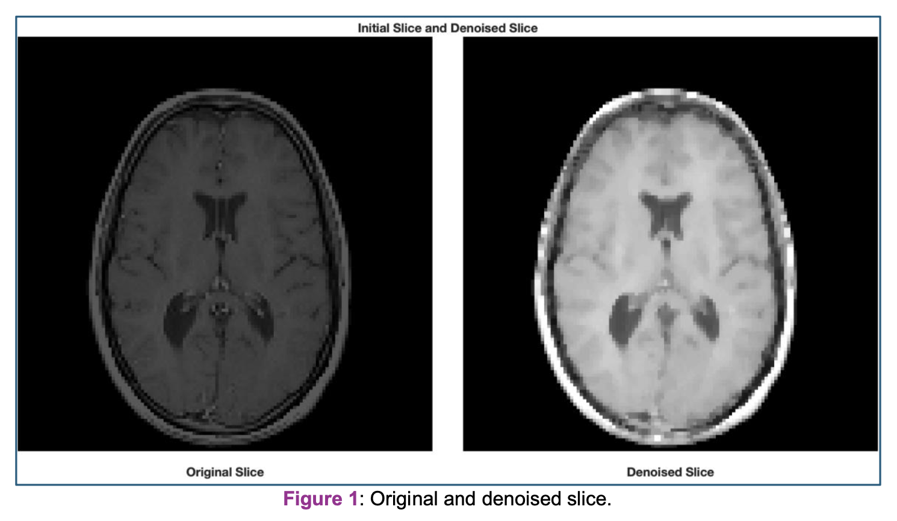

Slide 13
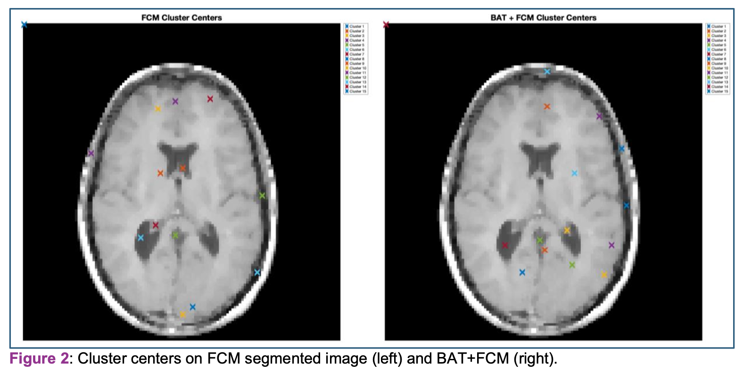
RESULTS
Performance Metrics:
Partition Coefficient (PC): Increased with BAT+FCM (0.667 vs. 0.654 for FCM).
Classification Entropy (CE): Decreased with BAT+FCM (0.865 vs. 0.892 for FCM).
Fuzzy Separation Index (S): Smaller with BAT+FCM, indicating better clustering.

Slide 14
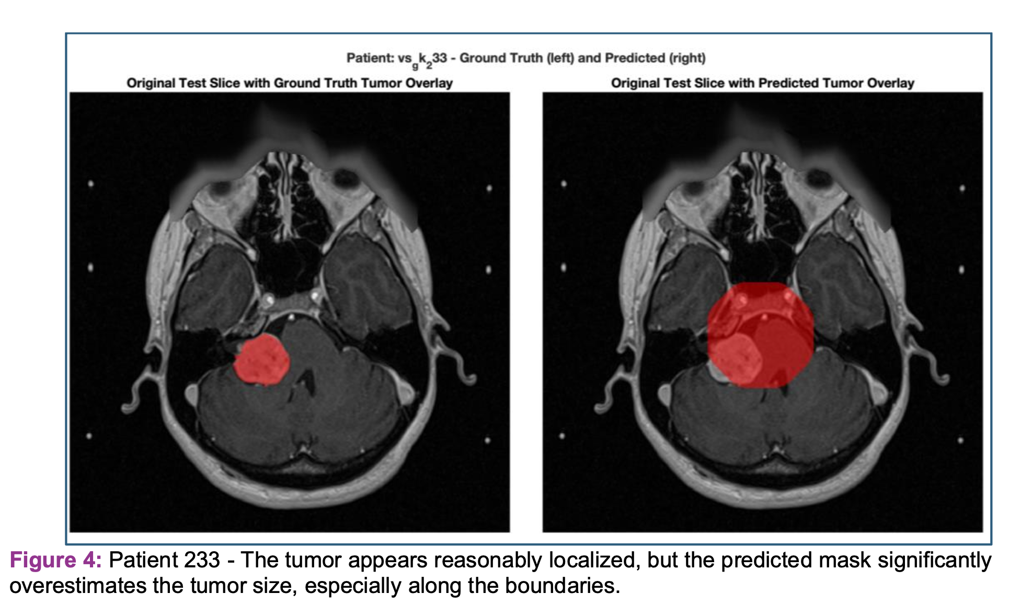

Slide 15
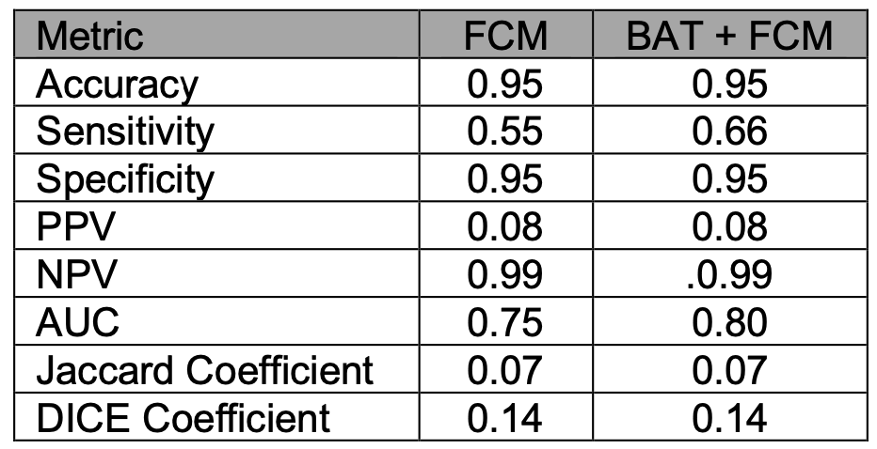

Suggestive of significant over-segmentation or inclusion of false positives in the tumor predictions.

Slide 16
LIMITATIONS
Observed Issues:
Over-segmentation: Predicted tumor masks often exceed actual tumor boundaries.
Boundary inaccuracies: Limited precision along irregular edges.
Low Positive Predictive Value (PPV): Only 8% of predicted tumor pixels were accurate.
Insights:
Histogram matching showed limited improvement in results.
Reliance on static parameters may reduce adaptability.

Slide 17

CONCLUSIONS
Key Findings:
BAT+FCM improves segmentation accuracy compared to FCM alone.
Enhances cluster initialization and reduces noise-related artifacts.
Over-segmentation with poor PPV.
Implications for Clinical Practice:
Supports better treatment planning by improving tumor localization.
Can potentially streamline workflows for radiologists and surgeons.
Future Directions:
Adaptive parameter tuning.
Larger datasets for validation.
Explore deep learning models to further enhance performance.

